Slide 1
MapReduce/Hadoop

Slide 2
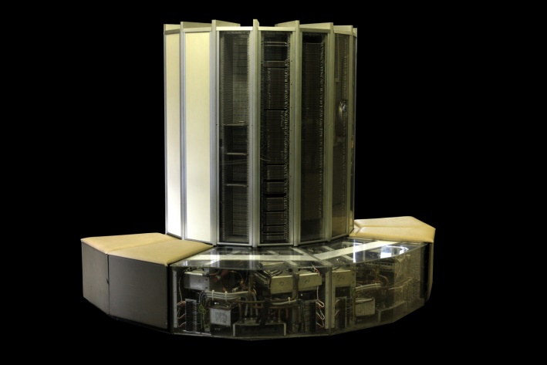
Early Large Scale Computing
Historically computation was processor-bound
Data volume has been relatively small
Complicated computations are performed on that data
Advances in computer technology has historically centered around improving the power of a single machine
Cray-1

Slide 3
Advances in CPUs
Moore’s Law
The number of transistors on a dense integrated circuit doubles every two years
Single-core computing can’t scale with current computing needs
Power consumption limits the speed increase we get from transistor density
Web-Scale data on the order of 100s of GBs to TBs or PBs
It is likely that the input data set will not fit on a single computer’s hard drive

Slide 4
Distributed Systems
Allows developers to use multiple machines for a single task
Programming on a distributed system is much more complex
Synchronizing data exchanges
Managing a finite bandwidth
Controlling computation timing is complicated
“You know you have a distributed system when the crash of a computer you’ve never heard of stops you from getting any work done.” –Leslie Lamport
Distributed systems must be designed with the expectation of failure

Slide 5
Commodity Clusters
Web data sets can be very large
Tens to hundreds of terabytes
Cannot mine on a single server (why?)
Standard architecture emerging:
Cluster of commodity Linux nodes
Gigabit ethernet interconnect
How to organize computations on this architecture?
Mask issues such as hardware failure

Slide 6
Cluster Architecture
2-10 Gbps backbone between racks
1 Gbps between
any pair of nodes
in a rack
Switch
Switch
Switch
CPU
CPU
CPU
CPU
Mem
…
Mem
Mem
…
Mem
Disk
Disk
Disk
Disk
Each rack contains 16-64 nodes

Slide 7
MapReduce
MapReduce is a programming model for data processing
The power of MapReduce lies in its ability to scale to 100s to 1000s of computers, each with several processor cores
MapReduce is designed to efficiently process large volumes of data by connecting many commodity computers together to work in parallel
MapReduce ties smaller and more reasonably priced machines together into a single cost-effective commodity cluster

Slide 8
Isolated Tasks
MapReduce divides the workload into multiple independent tasks and schedule them across cluster nodes
A work performed by each task is done in isolation from one another
The amount of communication which can be performed by tasks is mainly limited for scalability reasons
The communication overhead required to keep the data on the nodes synchronized at all times would prevent the model from performing reliably and efficiently at large scale

Slide 9
Data Distribution
In a MapReduce cluster, data is distributed to all the nodes of the cluster as it is being loaded in
An underlying distributed file systems (e.g., GFS) splits large data files into chunks which are managed by different nodes in the cluster
Even though the file chunks are distributed across several machines, they form a single namesapce.
Input data: A large file
Node 1
Node 2
Node 3
Chunk of input data
Chunk of input data
Chunk of input data

Slide 10
MapReduce core functionality
Two fundamental pieces:
Map Step:
Master node takes large problem input and slices it into smaller sub-problems; distributes these to worker nodes.
Worker node may do this again; leads to a multi-level tree structure
Worker processes smaller problem and hands back to the master
Reduce Step
Master node takes the answer to the sub-problem and combines them in a predefined way to get the output/answer to original problem

Slide 11
MapReduce core functionality (II)
Data flow beyond the two key pieces (map and reduce):
Input reader – divides input into appropriate size splits which get assigned to a Map function
Map function – maps file data to smaller, intermediate <key, value> pairs
Partition function – finds the correct reducer, given the key and number of reducers, returns the desired Reduce node
Compare function – input for Reduce is pulled from the Map intermediate output and stored according to this compare function
Reduce function – takes intermediate values and reduces to a smaller solution handed back to the framework
Output writer – writes file output

Slide 12
MapReduce core functionality (III)
A MapReduce Job controls the execution
Splits the input dataset into independent chunks
Processed by the map tasks in parallel
The framework sorts the output of the maps
A MapReduce Task is sent the output of the framework to reduce and combine
Both the inputs and outputs of the job are stored in a file system
Framework handles scheduling
Monitors and re-executes failed tasks

Slide 13
MapReduce: A Bird’s-Eye View
In MapReduce, chunks are processed in isolation by tasks called Mappers
The outputs from the mappers are denoted as intermediate outputs (IOs) and are brought into a second set of tasks called Reducers
The process of bringing together IOs into a set of Reducers is known as shuffling process
The Reducers produce the final outputs (FOs)
Overall, MapReduce breaks the data flow into two phases, map phase and reduce phase
chunks
C0
C1
C2
C3
Map Phase
M0
M1
M2
M3
mappers
IO0
IO1
IO2
IO3
Shuffling Data
Reduce Phase
Reducers
R0
R1
FO0
FO1

Slide 14
Keys and Values
The programmer in MapReduce has to specify two functions, the map function and the reduce function that implement the Mapper and the Reducer in a MapReduce program
In MapReduce data elements are always structured as key-value (i.e., (K, V)) pairs
The map and reduce functions receive and emit (K, V) pairs
Input Splits
Intermediate Outputs
Final Outputs
(K, V) Pairs
(K’, V’) Pairs
(K’’, V’’) Pairs
Map Function
Reduce Function

Slide 15
Partitions
In MapReduce, intermediate output values are not usually reduced together
All values with the same key are presented to a single Reducer together
More specifically, a different subset of intermediate key space is assigned to each Reducer. These subsets are known as partitions
Different colors represent
different keys (potentially)
from different Mappers
Partitions are the input to Reducers

Slide 16
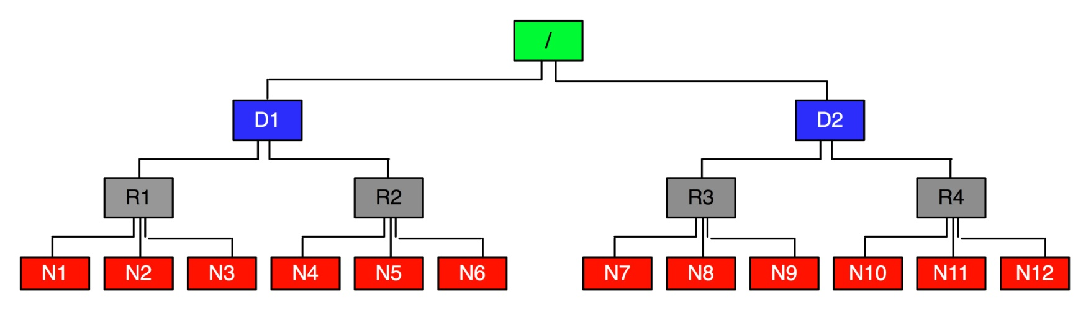
Network Topology in MapReduce
MapReduce assumes a tree style network topology
Nodes are spread over different racks embraced in one or many data centers
A salient point is that the bandwidth between two nodes is dependent on their relative locations in the network topology
For example, nodes that are on the same rack will have higher bandwidth between them as opposed to nodes that are off-rack

Slide 17
Distributed File System
Single Namespace for entire cluster
Data Coherency
– Write-once-read-many access model
– Client can only append to existing files
Files are broken up into blocks
– Typically 128 MB block size
– Each block replicated on multiple DataNodes
Intelligent Client
– Client can find location of blocks
– Client accesses data directly from DataNode

Slide 18
MapReduce: The Map Step
Input
key-value pairs
Intermediate
key-value pairs
k
v
map
k
v
k
v
map
k
v
k
v
…
…
k
v
k
v
Reads data as key/value pairs
The key is often discarded
Outputs zero or more key/value pairs

Slide 19
MapReduce: The Shuffle Step
Output
key-value pairs
Intermediate
key-value pairs
Key-value groups
reduce
k
v
k
v
v
v
k
v
reduce
k
v
k
v
v
k
v
group
k
v
…
…
…
k
v
k
v
k
v
Output from the mapper is sorted by key
All values with the same key are guaranteed to go to the same machine

Slide 20
MapReduce: The Reduce Step
Output
key-value pairs
Intermediate
key-value pairs
Key-value groups
reduce
k
v
k
v
v
v
k
v
reduce
k
v
k
v
v
k
v
group
k
v
…
…
…
k
v
k
v
k
v
Called once for each unique key
Gets a list of all values associated with a key as input
The reducer outputs zero or more final key/value pairs
Usually just one output per input key

Slide 21
MapReduce
Input: a set of key/value pairs
User supplies two functions:
map(k,v) → list(k1,v1)
reduce(k1, list(v1)) → v2
(k1,v1) is an intermediate key/value pair
Output is the set of (k1,v2) pairs

Slide 22
Word Count using MapReduce
map(key, value):
// key: document name; value: text of document
for each word w in value:
emit(w, 1)
reduce(key, values):
// key: a word; value: an iterator over counts
result = 0
for each count v in values:
result += v
emit(result)

Slide 23
Distributed Execution Overview
User
Program
fork
fork
fork
Master
assign
map
assign
reduce
Input Data
Worker
write
Output
File 0
local
write
Worker
Split 0
read
Split 1
Worker
Split 2
Output
File 1
Worker
Worker
remote
read,
sort

Slide 24
Data flow
Input, final output are stored on a distributed file system
Scheduler tries to schedule map tasks “close” to physical storage location of input data
Intermediate results are stored on local FS of map and reduce workers
Output is often input to another map reduce task

Slide 25
Coordination
Master data structures
Task status: (idle, in-progress, completed)
Idle tasks get scheduled as workers become available
When a map task completes, it sends the master the location and sizes of its R intermediate files, one for each reducer
Master pushes this info to reducers
Master pings workers periodically to detect failures

Slide 26
Failures
Map worker failure
Map tasks completed or in-progress at worker are reset to idle
Reduce workers are notified when task is rescheduled on another worker
Reduce worker failure
Only in-progress tasks are reset to idle
Master failure
MapReduce task is aborted and client is notified

Slide 27
How many Map and Reduce jobs?
M map tasks, R reduce tasks
Rule of thumb:
Make M and R much larger than the number of nodes in cluster
One DFS chunk per map is common
Improves dynamic load balancing and speeds recovery from worker failure
Usually R is smaller than M, because output is spread across R files

Slide 28
Combiners
Often a map task will produce many pairs of the form (k,v1), (k,v2), … for the same key k
E.g., popular words in Word Count
Can save network time by pre-aggregating at mapper
combine(k1, list(v1)) → v2
Usually same as reduce function
Works only if reduce function is commutative and associative

Slide 29
Partition Function
Inputs to map tasks are created by contiguous splits of input file
For reduce, we need to ensure that records with the same intermediate key end up at the same worker
System uses a default partition function e.g., hash(key) mod R
Sometimes useful to override
E.g., hash(hostname(URL)) mod R ensures URLs from a host end up in the same output file

Slide 30
Warm up: Word Count
We have a large file of words, one word to a line
Count the number of times each distinct word appears in the file
Sample application: analyze web server logs to find popular URLs

Slide 31
Word Count (2)
Case 1: Entire file fits in memory
Case 2: File too large for mem, but all <word, count> pairs fit in mem
Case 3: File on disk, too many distinct words to fit in memory
sort datafile | uniq –c

Slide 32
Word Count (3)
To make it slightly harder, suppose we have a large corpus of documents
Count the number of times each distinct word occurs in the corpus
words(docs/*) | sort | uniq -c
where words takes a file and outputs the words in it, one to a line
The above captures the essence of MapReduce
Great thing is it is naturally parallelizable

Slide 33
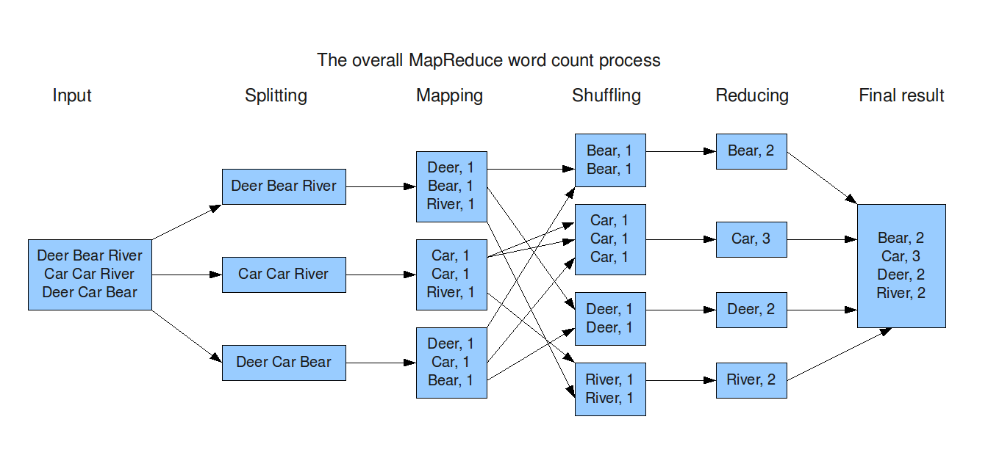
MapReduce: Word Count

Slide 34
Exercise 1: Host size
Suppose we have a large web corpus
Let’s look at the metadata file
Lines of the form (URL, size, date, …)
For each host, find the total number of bytes
i.e., the sum of the page sizes for all URLs from that host

Slide 35
Exercise 2: Distributed Grep
Find all occurrences of the given pattern in a very large set of files

Slide 36
Exercise 3: Graph reversal
Given a directed graph as an adjacency list:
src1: dest11, dest12, …
src2: dest21, dest22, …
Construct the graph in which all the links are reversed

Slide 37
Exercise 4: Frequent Pairs
Given a large set of market baskets, find all frequent pairs
Remember definitions from Association Rules lectures

Slide 38
Implementations
Google
Not available outside Google
Hadoop
An open-source implementation in Java
Uses HDFS for stable storage
Download: http://lucene.apache.org/hadoop/
Aster Data
Cluster-optimized SQL Database that also implements MapReduce
Made available free of charge for this class

Slide 39
What is Apache Hadoop?
Large scale open source software framework
Yahoo! has been the largest contributor to date
Dedicated to scalable, distributed, data-intensive computing
Handles thousands of nodes and petabytes of data
3 Hadoop subprojects:
Hadoop Common: common utilities package
HDFS: Hadoop Distributed File System with high throughput access to application data
MapReduce: A software framework for distributed processing of large datasets on computer clusters

Slide 40
Hadoop MapReduce
MapReduce is a programming model and software framework first developed by Google (Google’s MapReduce paper submitted in 2004)
Intended to facilitate and simplify the processing of vast amounts of data in parallel on large cluster of commodity hardware in a reliable, fault-tolerant manner
Petabytes of data
Thousands of nodes
Computational processing occurs on both:
Unstructured data: Filesystem
Structured data: database

Slide 41
Core Hadoop Concepts
Applications are written in a high-level programming language
No network programming or temporal dependency
Nodes should communicate as little as possible
A “shared nothing” architecture
Data is spread among the machines in advance
Perform computation where the data is already stored as often as possible

Slide 42
High-Level Overview
When data is loaded onto the system it is divided into blocks
Typically 64MB or 128MB
Tasks are divided into two phases
Map tasks which are done on small portions of data where the data is stored
Reduce tasks which combine data to produce the final output
A master program allocates work to individual nodes
Notes:
Example of map and reduce

Slide 43
Requirements for Hadoop
Simplicity – MapReduce jobs are easy to run. Applications can be written in any language such as java, C++, and python.
Scalability
Increasing resources should increase load capacity
Increasing the load on the system should result in a graceful decline in performance for all jobs and not system failure
Speed – By means of parallel processing problems that take days to solve, it is solved in hours and minutes by MapReduce.

Slide 44
Requirements for Hadoop
Fault Tolerance – Must support partial failure. Failure of a single component must not cause the failure of the entire system only a degradation of the application performance.
Failure should not result in the loss of any data
If one copy of data is unavailable, another machine has a copy of the same key pair which can be used for solving the same subtask.
Component Recovery: If a component fails, it should be able to recover without restarting the entire system
Component failure or recovery during a job must not affect the final output

Slide 45
Fault Tolerance
Failures are detected by the master program which reassigns the work to a different node
Restarting a task does not affect the nodes working on other portions of the data
If a failed node restarts, it is added back to the system and assigned new tasks
The master can redundantly execute the same task to avoid slow running nodes

Slide 46
Uses for Hadoop
Data-intensive text processing
Graph mining
Machine learning and data mining
Large scale social network analysis

Slide 47
















Who Uses Hadoop?

Slide 48
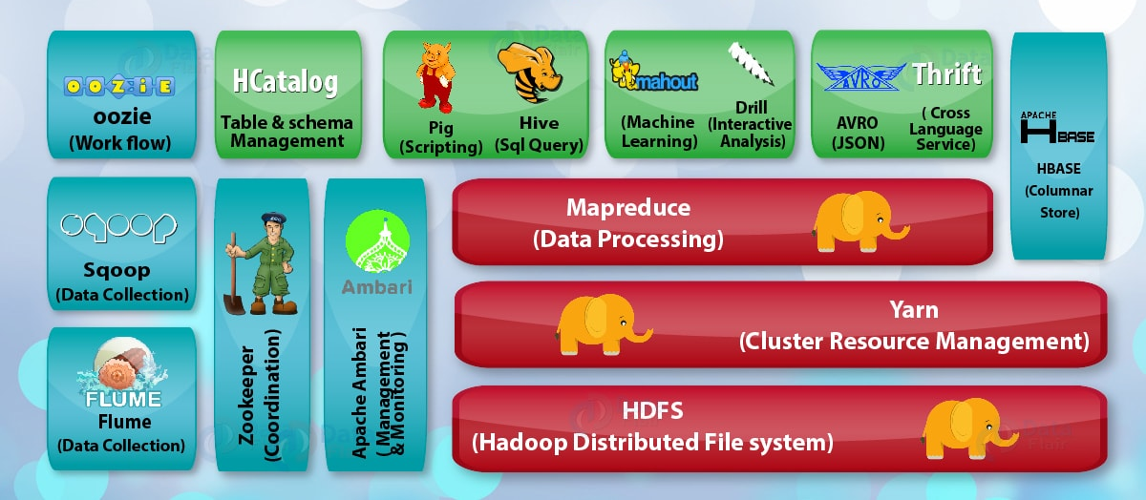
The Hadoop EcoSystem

Slide 49
The Hadoop Ecosystem
Ambari
Management & Monitoring tool
HDFS
Hadoop Distributed File System
Hadoop YARN
Yet Another Resource Negotiator
Hadoop MapReduce
A programming model for large scale data processing

Slide 50
Why do these tools exist?
MapReduce is very powerful, but can be awkward to master
These tools allow programmers who are familiar with other programming styles to take advantage of the power of MapReduce

Slide 51
Other Tools
Hive
Hadoop processing with SQL
Pig
Hadoop processing with scripting
Cascading
Pipe and Filter processing model
HBase
Database model built on top of Hadoop
Flume
Designed for large scale data movement

Slide 52
Stable storage
First order problem: if nodes can fail, how can we store data persistently?
Answer: Distributed File System
Provides global file namespace
Google GFS; Hadoop HDFS; Kosmix KFS
Typical usage pattern
Huge files (100s of GB to TB)
Data is rarely updated in place
Reads and appends are common

Slide 53
Distributed File System
Chunk Servers
File is split into contiguous chunks
Typically each chunk is 16-64MB
Each chunk replicated (usually 2x or 3x)
Try to keep replicas in different racks
Master node
a.k.a. Name Nodes in HDFS
Stores metadata
Might be replicated
Client library for file access
Talks to master to find chunk servers
Connects directly to chunkservers to access data

Slide 54
Hadoop Distributed File System (HDFS)
Inspired by Google File System
Scalable, distributed, portable filesystem written in Java for Hadoop framework
Primary distributed storage used by Hadoop applications
HDFS can be part of a Hadoop cluster or a stand-alone general purpose distributed filesystem

Slide 55
Hadoop Distributed File System (HDFS)
An HDFS cluster primarily consists of
NameNode that manages filesystem metadata
DataNode that stores actual data
Stores very large files in blocks across machines in a large cluster
Reliability and fault tolerance ensured by replicating data across multiple hosts
Current block replication is 3 (configurable)
It cannot be directly mounted by an existing operating system.
Has data awareness between nodes
Designed to be deployed on low-cost hardware
Each block is replicated multiple times

Slide 56
HDFS: How the files are stored
Files are split into blocks
Blocks are split across many machines at load time
Different blocks from the same file will be stored on different machines
Blocks are replicated across multiple machines
The NameNode keeps track of which blocks make up a file and where they are stored

Slide 57
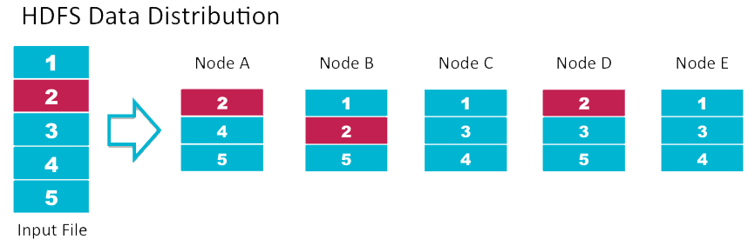
Data Replication
Default replication is 3-fold

Slide 58
Data Retrieval
When a client wants to retrieve data
Communicates with the NameNode to determine which blocks make up a file and on which data nodes those blocks are stored
Then communicated directly with the data nodes to read the data

Slide 59
Typical Hadoop cluster integrates MapReduce and HDFS
Master/slave architecture
Master node contains
Job tracker node (MapReduce layer)
Task tracker node (MapReduce layer)
Name node (HDFS layer)
Data node (HDFS layer)
Multiple slave nodes contain
Task tracker node (MapReduce layer)
Data node (HDFS layer)

Slide 60
Overview
NameNode
Holds the metadata for the HDFS
Secondary NameNode
Performs housekeeping functions for the NameNode
DataNode
Stores the actual HDFS data blocks
JobTracker
Manages MapReduce jobs
TaskTracker
Monitors individual Map and Reduce tasks

Slide 61
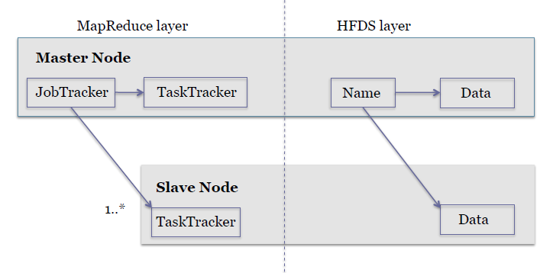
Hadoop simple cluster graphic

Slide 62
MapReduce Framework
Per cluster node:
Single JobTracker per master:
Responsible for scheduling the jobs’ component tasks on the slaves
Monitors slave progress
Re-executing failed tasks
Single TaskTracker per slave
Executes the tasks as directed by the master

Slide 63
The NameNode
Stores the HDFS file system information in a fsimage
Updates to the file system (add/remove blocks) do not change the fsimage file
They are instead written to a log file
When starting the NameNode loads the fsimage file and then applies the changes in the log file

Slide 64
The Secondary NameNode
NOT a backup for the NameNode
Periodically reads the log file and applies the changes to the fsimage file bringing it up to date
Allows the NameNode to restart faster when required

Slide 65
JobTracker and TaskTracker
JobTracker
Determines the execution plan for the job
Assigns individual tasks
TaskTracker
Keeps track of the performance of an individual mapper or reducer

Slide 66
Tasks of NameNode
Manage file system namespace.
Regulates client’s access to files.
Executes file system execution such as naming, closing, opening files and directories.

Slide 67
Tasks of DataNode
DataNode performs operations like block replica creation, deletion, and replication according to the instruction of NameNode.
DataNode manages data storage of the system.

Slide 68
HDFS Architecture
NameNode
1. filename
2. BlckId, DataNodes
o
Secondary
NameNode
Client
3.Read data
DataNodes
NameNode : Maps a file to a file-id and list of MapNodes
DataNode : Maps a block-id to a physical location on disk
Notes:
68

Slide 69
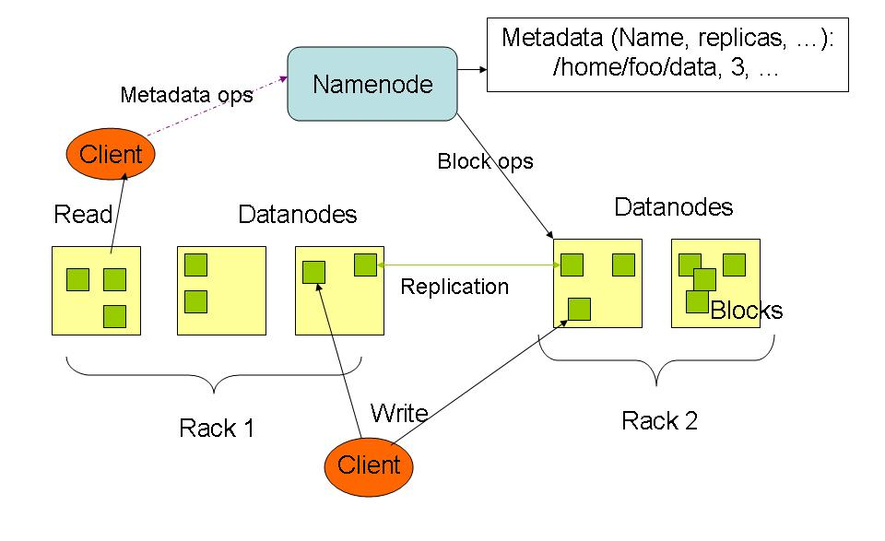
HDFS Architecture
https://www.youtube.com/watch?v=m9v9lky3zcE

